Slide 1
DATASITES

Slide 2
FINE-TUNING

Slide 3
Website features
Integration Of 10 Languages into the website:
Mobile compatibility
User-friendly platform
LANGUAGE | BLEU SCORE
HINDI | 43.9
MARATHI | 33.5
GUJARATI | 40.3
BENGALI | 29.6
KANNADA | 36.4
ODIA | 34.4
TELUGU | 36.2
MALAYALAM | 34.6
PUNJABI | 43.2

Slide 4
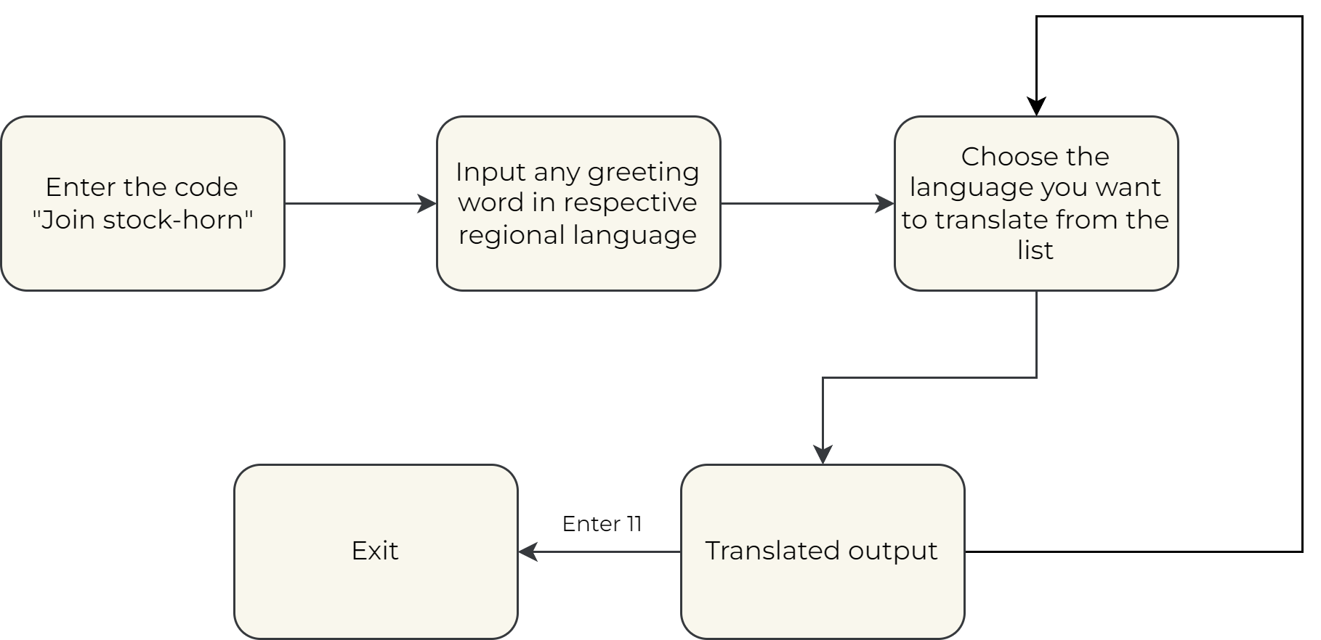
CHATBOT WORKFLOW

Slide 5
CHALLENGES
DIVERSITY OF INDIAN LANGUAGES
LIMITED OPPORTUNITIES
As there are 22 official languages and 122 total languages and dialects in India, it is a real challenge to cover all of these aspects in a single service and thus its being neglected.
Due to lack of translation services and the less ratio of English speakers in India many people are unable to get the benefit of opportunities suited to them.
COMMUNICATION BARRIERS
ABSENCE OF A UNIFIED PLATFORM
Solving the communication barrier with all of the diverse cultures and mother tongues in India is a real challenge as it is prominent not only in the rural areas but every part of the country.
There is no one stop solution in India to avail language services for customers and businesses alike. This makes it very unorganised and time consuming.

Slide 6
TECHNOLOGY STACK
TWILIO
FLASK API
Conversational API to setup the WhatsApp Sandbox
Communication between the backend and WhatsApp at client’s end

Slide 7
Statistics
9/10
5.2%
40%
9 out of 10 Indians on the internet are non-English users, with rural penetration up to 57% now and growing.
Europe accounts for about half of the worldwide language services market (49%), While India only shares 5.2% of the global market.
During COVID-19, the translation service industry rose by 40%.

Slide 8
Solutions
LOW RESOURCE languages
Solutions for languages that are less spoken by the mass
COMMUNICATION
Help people interpret information more easily and efficiently
LOCALISATION
Expanding the businesses of the local people by connecting them with the world
User friendly
An all-inclusive translation platform service that provides a user friendly multilingual interface

Slide 9
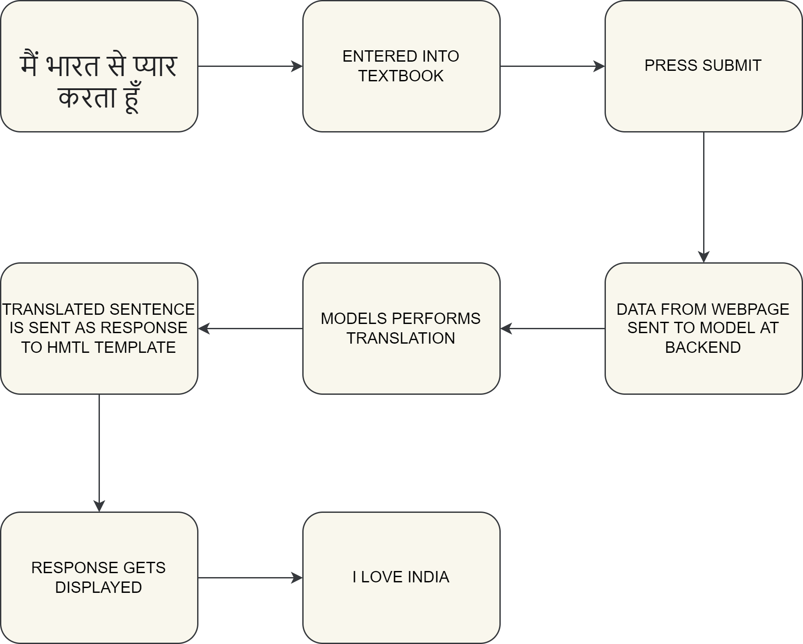
WEBSITE WORKFLOW

Slide 10
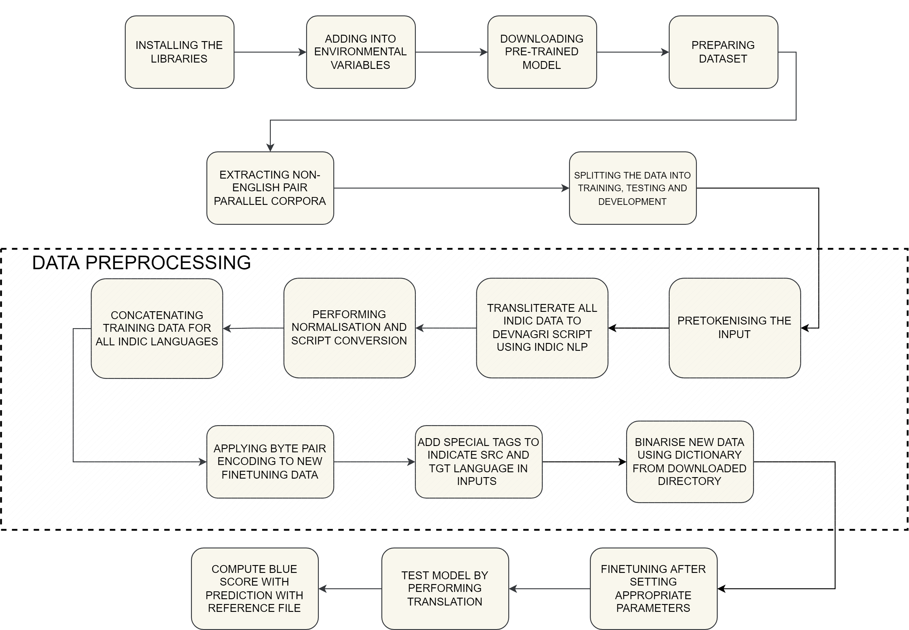
FINE TUNING

Slide 11
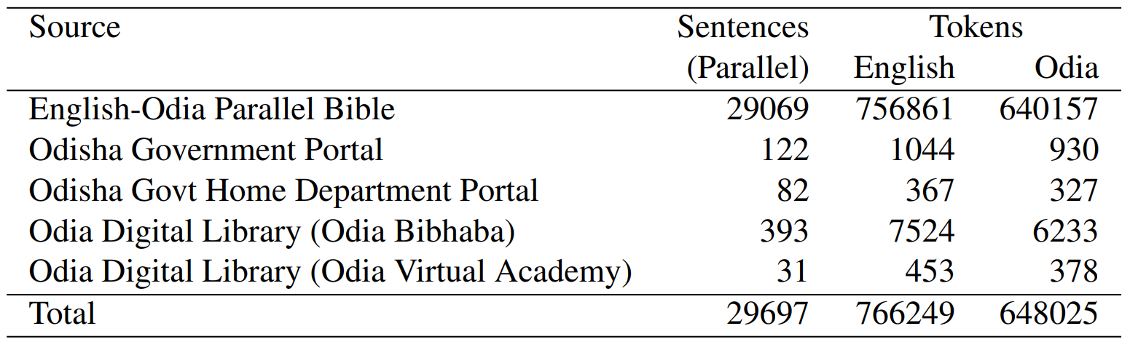
DATA SOURCES
CVIT-PIB, PMIndia, IITB 3.0, JW, NLPC, UFAL EnTam, Uka Tarsadia, Wiki Titles (ta, gu), ALT, OpenSubtitles, Bible-uedin, MTEnglish2Odia, OdiEnCorp 2.0, TED, WikiMatrix.

Slide 12
USE CASES
local Businesses
MSMEs
TOURISM
Education

Slide 13
THANK YOU

